Slide 1

Time Series Forecasting Platform
(Brent Crude Oil)
Akil Mohamed Firos
Student id - 219015127
MSc AI for Business Intelligence
Academic Supervisor - Andrew Morozov
Sprint 1.1 Data Collection & Research

Slide 3
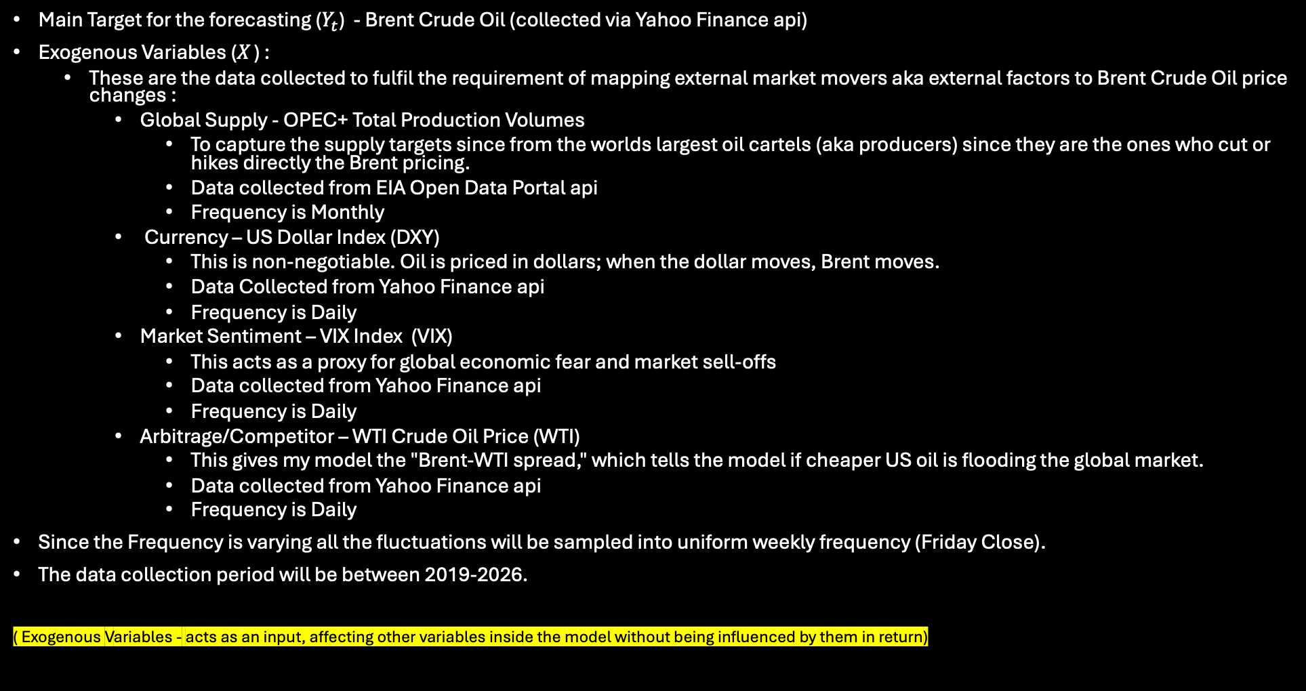
Dataset info
Main Target for the forecasting ($Y_{t}$) - Brent Crude Oil (collected via Yahoo Finance api)
Exogenous Variables ($X_{ }$) :
  These are the data collected to fulfil the requirement of mapping external market movers aka external factors to Brent Crude Oil price changes :
    Global Supply - OPEC+ Total Production Volumes
      To capture the supply targets since from the worlds largest oil cartels (aka producers) since they are the ones who cut or hikes directly the Brent pricing.
      Data collected from EIA Open Data Portal api
      Frequency is Monthly
    Currency – US Dollar Index (DXY)
      This is non-negotiable. Oil is priced in dollars; when the dollar moves, Brent moves.
      Data Collected from Yahoo Finance api
      Frequency is Daily
    Market Sentiment – VIX Index (VIX)
      This acts as a proxy for global economic fear and market sell-offs
      Data collected from Yahoo Finance api
      Frequency is Daily
    Arbitrage/Competitor – WTI Crude Oil Price (WTI)
      This gives my model the "Brent-WTI spread," which tells the model if cheaper US oil is flooding the global market.
      Data collected from Yahoo Finance api
      Frequency is Daily
Since the Frequency is varying all the fluctuations will be sampled into uniform weekly frequency (Friday Close).
The data collection period will be between 2019-2026.
( Exogenous Variables - acts as an input, affecting other variables inside the model without being influenced by them in return)

Slide 4

Machine Learning info
Before building out the model there are pre-preparation to do :
  ML Model don’t inherently understand the chronological date and time
  To tackle that the uniform weekly data frame is converted using a technique called Windowing / Lagging technique.
  The idea is to place the past metrics side by side with future targets in a tabular grid.
  This is the formula it will follow $Y_{t}=f(Y_{t−1} , X_{t−1})$
Model Category | ML Algorithm | How it affects Brent Dataset? | Project Purpose
Statistical Baseline | SARIMAX | Takes weekly Brent prices as the primary dependent variable (Y) and natively processes DXY, VIX, WTI, and OPEC data as an exogenous (X) matrix. | Parses traditional linear components to establish a hard econometric baseline.
Machine learning | XGBoost & Random Forest | Goes through chronological rows of tabular lag features (t-1, t-2) across all target and exogenous variables simultaneously. | Maps highly complex, non-linear market interactions (e.g., a massive OPEC supply drop paired with high market anxiety triggering an exponential price spike).
Future Selection | LASSO Regression | Tests linear combinations of the regressors and mathematically penalizes unhelpful variables by shrinking their coefficients to absolute zero. | Evaluates which external market drivers are genuinely influential, automatically filtering out the noise.
Deep Learning | LSTM Neural Network | Processes sequential weekly data arrays using internal "memory gates". | Preserves long-term structural supply shocks (like permanent OPEC+ quota shifts) without forgetting them as new weekly data streams in.
The regressor in the Lasso Regression is the historical data we feed to the model like the last week's oil prices, the strength of the US Dollar, and stock market fear, etc.

